Slide 1
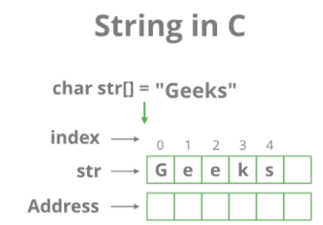
Strings in C
Strings are defined as an array of characters.

Slide 2

Declaration of strings
Declaring a string is as simple as declaring a one-dimensional array. Below is the basic syntax for declaring a string.

Slide 3
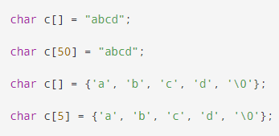

Initializing a String
You can initialize strings in a number of ways.

Slide 4
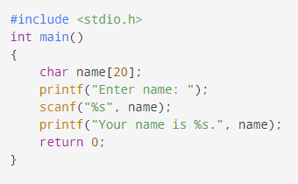
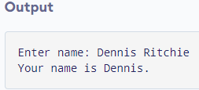
Read String from the user
The scanf() function reads the sequence of characters until it encounters whitespaces (spaces,newline,tab,etc.).

Slide 5
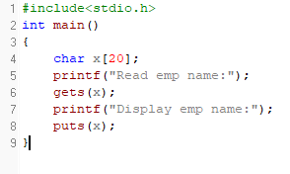
Read a line of text
You can use the gets() function to read a line of string. And, you can use puts() to display the string.

Slide 6
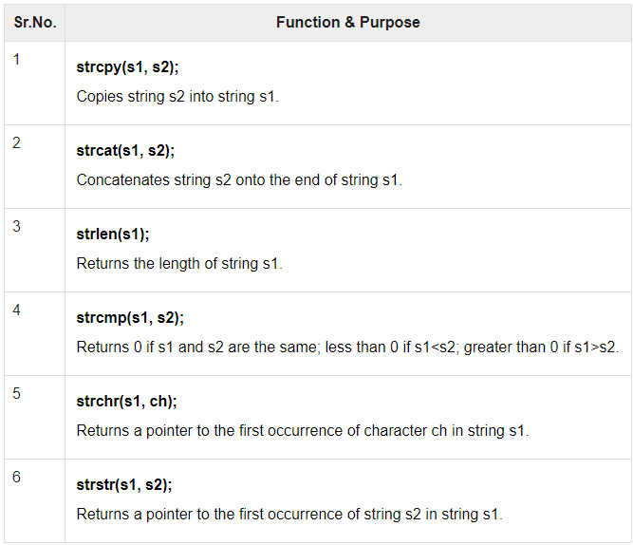
Strings functions
C supports a wide range of functions that manipulate null-terminated strings.

Slide 7
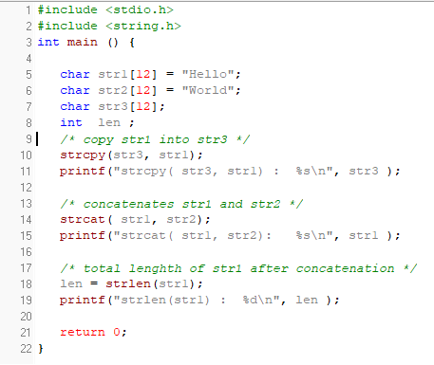

Slide 9
Accident Problem
Each year the Department of Traffic Accidents receives accident count reports from a number of cities and towns across the country. Given details of ‘n’ days, develop an algorithm and write a program to determine the average number of accidents and for each day, print the difference between the number of accidents on that day and average. For example, if the number of accidents is 5 and the values are 10, 12, 15, 13, 5 then average is 11 and the difference of values are 1, 1, 4, 2, 6

Slide 10
Accident problem
Input | Output | Logic Involved
Value of ‘n’, the number of accidents | Average and ‘n’ values that is the difference between average and value | Find average and difference

Slide 11
Algorithm
Read the value of ‘n’
Read the number of accidents happened in ‘n’ days
Find average
For each value print the difference between average and the value

Slide 12
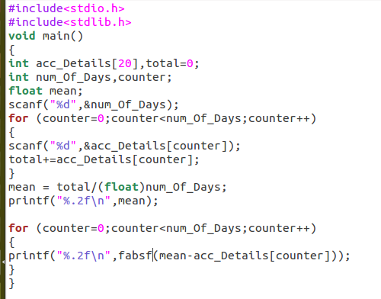

Slide 13
Huffman Coding Problem
Huffman code is a particular type of optimal prefix code for characters. It is commonly used for lossless data compression. It is a variable-length code derived from frequency of occurrence. Given a string develop an algorithm and write a C program to determine frequency of occurrence of each character in the string.

Slide 14
Huffman Coding problem
Input | Output | Logic Involved
A string S | Frequency count of each letter in S | Convert all letters to uniform case and check if it is a particular letter and increment corresponding count

Slide 15
Algorithm
Read a string
Make all letters in the string to be in lowercase
Process character by character
If the character is an alphabet then increment count of it
Print count of all alphabets

Slide 16
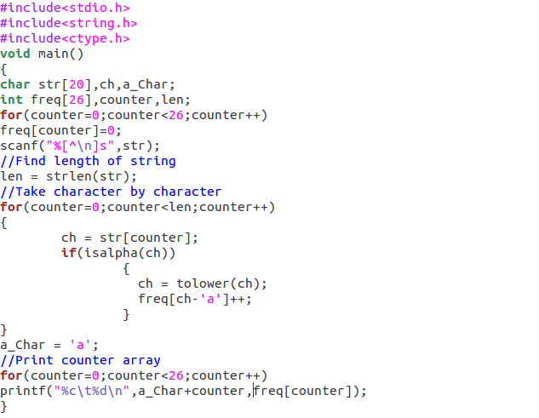

Slide 17

Tic Tac Toe Problem
Tic-tac-toe is a paper-and-pencil game for two players, X and O, who take turns marking the spaces in a 3×3 grid. Player who succeeds in placing three of their marks in a horizontal, vertical, or diagonal row wins the game.

Slide 18
Tic Tac Toe Problem Contd...
Given the board configuration of the tic tac toe game, determine if the board is in either of the following states: empty, player1 wins, player2 wins, draw or intermediate. The board is said to be in initial state if all the cells contain ‘-1’, player1 uses ‘1’ as his coin and player2 uses ‘2’ as his coin. The game is draw when the board is full and no one has won the game. The game is in intermediate state when no one has won and board is not full

Slide 19
Tic Tac Toe problem
Input | Output | Logic Involved
Current board configuration | State of the board as win, draw, initial or intermediate | Find average and difference

Slide 20
Algorithm
Represent the board in memory
Get the elements in first row, second row and so on
Process the elements
If all are -1 then print ‘empty’
If ‘1’ is placed row wise, column wise or diagonally then print ‘Player 1’ wins
If ‘2’ is placed row wise, column wise or diagonally then print ‘Player 2’ wins
If all cells are full and no one has won the game then print ‘Draw’
Otherwise print intermediate

Slide 21
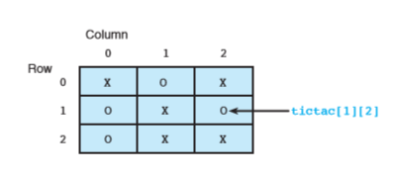
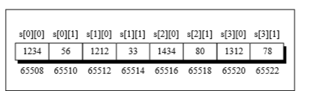
Representation of Tic Tac Toe Board

Slide 22
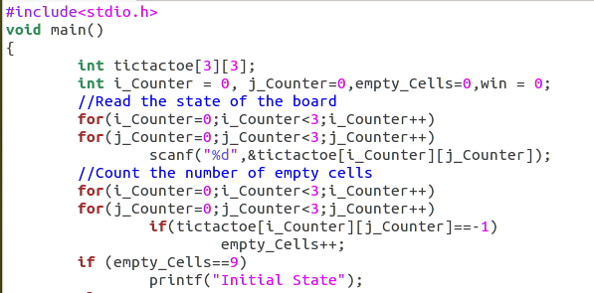

Slide 23
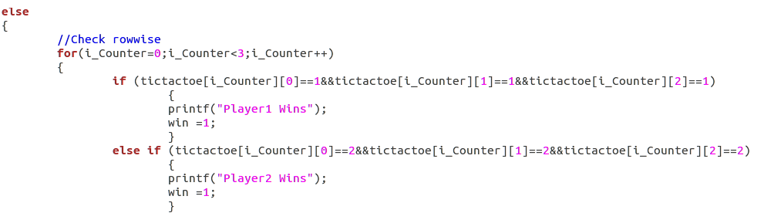

Slide 24
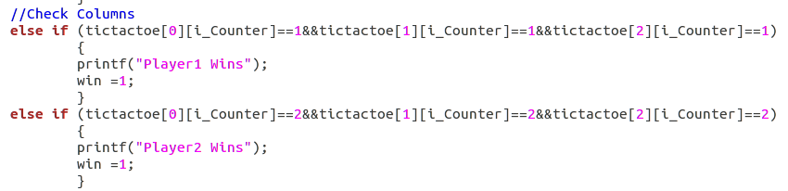

Slide 25
